Slide 1
NLP Feature engineering and model diagnostics
MANAS RANJAN KAR
AVP, NLP & DATA SCIENCE
EPISOURCE

Slide 2
$ whoami
Head data science and machine learning @ Episource
Finance, healthcare, retail, e-commerce
Contributor: gensim, ConceptNet
GH @ manasRK

Slide 3
AGENDA
Broad use case
Clinical Data – Why is it hard
Case Study – Identifying contextual “diseases”
Building features for context
Experiment Setup
Model building and diagnostics
QA

Slide 4
BROAD USE CASE
Build a secure, scalable, cost efficient NLP engine for IE/IR from medical transcripts
🔒Secure - HIPAA compliance, secure both in transit and rest
📈Scalable - processing thousands of charts on daily basis
💵Cost efficient - less resources (cost) to achieve greater output (accurate quality)
Reducing turnaround time (TAT) by building Computer Assisted Coding (CAC) tool
Hierarchical Condition Category (HCC) Chart categorization:
HCC Billable ✅ e.g. Viral Fever - A92.8
No HCC Non Billable ❌ e.g. Whooping cough - A37
Augmenting clients specific needs, guidelines into NLP engine

Slide 5
WORKING THROUGH
a. Working with lot of text requires answers to below questions:
What is source of data?
Is it streaming data or stationary dumps?
Understanding expectations of stakeholders
Business use
Need of Text Classification – IE/IR with regex, NER, Dependency parsing, Embeddings?
b. Existing solutions on GitHub, arxiv, academic shared tasks available?
c. Need of labelled data? Resources to label them? Budget? Domain experts?

Slide 6
NLP FOR CLINICAL TEXT
PROCESS | OUTCOMES
Load | “The patient is suffering from high blood pressure. Diagnosed with DM2, no murmurs found”
Clean | “the patient is suffering from high blood pressure. diagnosed with dm2, no murmurs found”
Tokenize | <START> the, patient, is, suffering, from, high, blood, pressure, <END>, <START> diagnosed, with, dm2, no, murmurs, found <END>
Vectorize | <START> [0.1,0.2], [0.3,0.05], [0.15,0.12], [0.4,0.2], [0.6,0.22], [0.21,0.6], [0.11,0.22], [0.51,0.22], <END>, <START> [0.6,0.2], [0.4,0.6], [0.7,0.4], [0.19,0.42], [0.3,0.6], [0.4,0.3]<END>
Train & Predict | “The patient is suffering from high blood pressure. Diagnosed with DM2, no murmurs found”

Slide 7
WHAT MAKES CLINICAL DATA HARD?
In contrast to normal english text (newspapers, blog posts), clinical text is written by health care professionals to communicate the status and history of a single patient to other health care professionals or themselves.
Flexible formatting
Variable formatting semantics: Section header: “Admitting Diagnosis: SPLENOMEGALIA” Inseparable phrase: “Neuro: nonfocal”
Structure without sentences: “Height: (in) 75 Weight (lb): 245 BSA (m2): 2.39 m2 BP (mm Hg): 92/52 HR (bpm): 120” “Digoxin 250 mcg Tablet Sig: One (1) Tablet PO DAILY (Daily).”
Missing punctuation: no m/r/g b/l coarse rhonchi w/assoc upper airway sounds. Well appearing male in no acute distress Chest is clear No hernias

Slide 8
WHAT MAKES CLINICAL DATA HARD?
2. Atypical grammar:
Missing expected words: Verb: “No pneumothorax.” Articles: “Ultrasound showed no evidence of [a] pseudoaneurysm.”
3. Variety of textual subjects:
Patient: “Awake, alert and oriented times three.”
Family: “mother had CABG grandmother had CAD”
4. Temporality:
He was also tachycardic
He had a fingerstick of 142
5. Language specific to medical context:
Jargon: “septic picture likely aspiration pneumonia secondary to dobhoff placement.”
Abbreviations: “recent tension PTX at OSH”
6. Misspellings: “Chrones disease”, “Hyprtension”

Slide 9
WHAT MAKES CLINICAL DATA HARD?
Identifying Disease is a difficult task due to:
7. Wide variety of naming patterns for diseases Hypertension, HTN, Hypertensive 8. Ambiguity SLE -> systemic lupus erythematosus SLE -> slit-lamp examination 9. Term variation: Edema -> Swelling 10. Idiosyncrasies of clinical text:Disjoint mention: A tumor was found in the left ovary -> ovarian neoplasm Inference: On admission, BP was 140/90 mmHg -> abnormal BP

Slide 10
CASE STUDY
Handling a disease (DX) context

Slide 11
Sample Document
PAST MEDICAL HISTORY:
Patient visited us yesterday. He complained of back pain and slight nausea, not been sleeping well. His blood tests revealed low Hb levels. His insulin dosage has been stable as well.
For diabetes, a low carb, sugar free diet is a must. However, given the current diabetes status of the patient, it’s difficult to recommend a stable diet.
ASSESSMENT:
Type 2 DM
Chronic Kidney Disease Stage IV
Hypertension

Slide 12
EXAMPLES
CONTEXT 1 | CONTEXT 2
HIV exposure | HIV disease
chronic infection | chronic bronchitis
stable retinopathy | Diabetic retinopathy
Mastectomy- RT (acquired absence of breast) | acquired absence of limb
depression | depression in EKG
hearing aids | AIDS
diverticula of the sigmoid colon | Cancer of sigmoid colon

Slide 13
Context Features - I
A valid DX will have information about;
Who is the experiencer?
“He has diabetes” vs “His mother is suffering from diabetes”
Is it chronic or acute? When was this diagnosed?
“Knee Pain” vs “Diabetes”
“Patient is suffering from CKD since past couple years”
Which section is the DX mentioned?
“Past Medical History” vs “Family History”

Slide 14
Context Features - II
Any evidence of DX
Insulin with Diabetes
No negation
“Denies cough, fever, nausea, chills”
No “suspect” terms
“Risk of diabetes, cancer screening”

Slide 15
Experiment Setup
ATTRIBUTE | VALUE
Classifiers | SVM, LGBM, MLP, CNN, Ensembles
Data | 10K sentences
Metric | F1, ROC
Threshold | 0.15 - 0.22
Results | 0.73 F1, 0.92 ROC

Slide 16
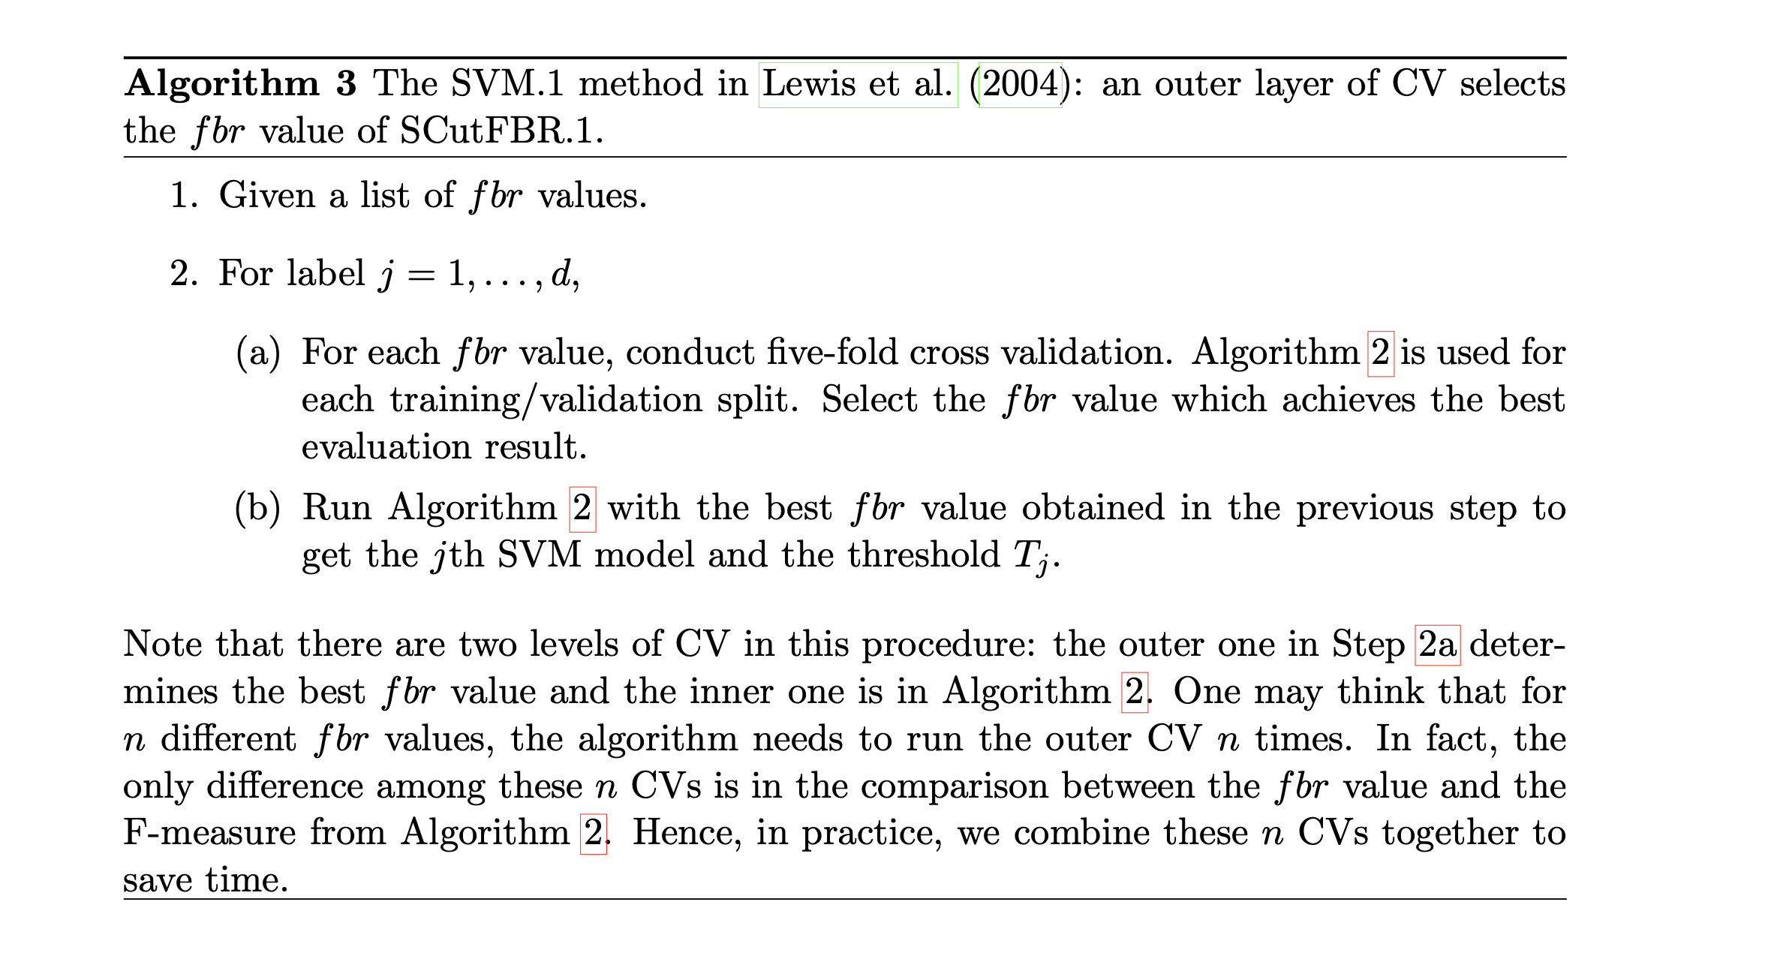
F1 – Choosing a threshold
A Study on Threshold Selection for Multi-label Classification , Rong-En Fan and Chih-Jen Lin

Slide 17
Problems in Estimation
DX can occur in similar context , and have different labels
Mislabelled data
Class Imbalance
Annotator disagreement
Broken Tokenization due to text format

Slide 18
QUESTIONS? Github: manasRK Twitter: manasrnkar Email: manas@episource.com

